Slide 1

Welcome !
6th Annual Datawise Users Conference & Professional Development Workshop
Building Assessments to Inform Instruction and Intervention
Gerald R Williams -Placer County Office of Education
Coordinator Assessment & Program Improvement
November 4th & 5th, 2009
Gerald Williams- Coordinator Data Analysis and Program Improvement
March 16th, 2009
Notes:
1

Slide 2
Objectives for today
Examine the role of Formative Assessments in Professional Learning
Communities (PLC’s) & Response to Intervention (RTI)
Examine one protocol for formative assessment data analysis
You will leave this workshop today with:
  a high quality formative assessment, and
  the skills necessary to assist others in your district in development of
  high quality formative assessments
We will have answered the questions:
  What constitutes a highly effective formative assessment?
  How does Datawise facilitate the effective use of formative assessment
  data?
  What constitutes a highly effective & efficient Intervention?

Slide 3
Sources
“How to Prepare Better Multiple Choice Items: Guidelines for University Faculty”, Brigham Young University Testing Services & The Department of Instructional Science. 1991
“Accountability for Learning: How Teachers and School Leaders can Take Charge”, Douglas Reeves, 2004
“Writing and Reviewing Assessment Items: Guidelines and Tip”, John Painter Ph.D., University North Carolina Chapel Hills. 2004
“Writing Test Items: Selected Response Assessments”, The Center for Assessment & Research Studies, James Madison University. 2006
“Common Formative Assessments”, Larry Ainsworth, 2006
Ahead of the Curve: The Power to Transform Teaching and Learning, Douglas Reeves, 2007
Learning By Doing, DuFour, DuFour, Eaker, Many, 2006
“Revisiting Professional Learning Communities at Work: New Insights for Improving Schools”, DuFour, DuFour, Eaker, 2008

Slide 4
A Balanced Assessment Program
Assessment
“OF”
Summative
Norm or Standards Referenced
Often Teacher Made
A Snapshot in Time
An Autopsy
Essential Question:
What have students already learned?
Assessment
“FOR”
Formative
Standards Based
Teacher-Made
A Moving Picture
A Diagnosis Leading to Focused Instruction
Essential Question:
How can we help students learn more?

Slide 5
Quality Assessment
Accurate Assessment
Clear Purposes Why Assess?
What’s the purpose?
Who will use the results?
Clear Targets
Assess What?
What are the learning targets?
Are they clear?
Aligned to Pacing?
Good Design
Assess How?
What method?
Sampled how?
Avoid bias how?
Effectively Used
Sound Communication
How to communicate?
How to manage information?
How to report data?
Staff
How do we use the results?
What are the specific needs of individual
students?
What additional data do we need?
Student Involvement
Students are users too.
Students need to understand learning targets.
Students can track progress and communicate.

Slide 6
Effective Schools Research
Teachers will pay more attention to the alignment that must exist between intended, taught, and assessed curriculum.
In the area of assessment the emphasis will shift away
from standardized norm-referenced tests toward
curriculum-based criterion referenced measures of student
mastery.
Technology will allow teachers to do a better job
monitoring their students’ progress.
Larry Lazotte

Slide 7
Why pacing? Aren’t we just “teaching to the test”?
Pacing provides a “guideline” for teachers to ensure that they have given students the opportunity to learn what they need to know and what they’re held accountable for on high-stakes tests.
It also affords the opportunity to use common assessments to promote consistency from teacher to teacher, section to section.
Pacing should never be used as a reason to “go on” without additional instruction, i.e.re-teach or intervention.

Slide 8
Without data you are just another person with an opinion.
Today’s school leaders shift both their own focus and that of the community from inputs to outcomes and from intentions to results.
A focus on learning vs. teaching.

Slide 9
Formative Assessment Review/Revise Process
A review of over 250 articles by researchers from several countries established that improving formative assessments raises achievement. Few initiatives in education have had such a strong body of evidence to support a claim to raise standards.
Paul Black, et. al

Slide 10
Formative Assessment
“Firm evidence shows that formative
assessment is an essential component of
classroom work and that its development
can raise standards of achievement.”
P. Black & D. Williams (1998) inside the Black Box: Raising Standards
Through Classroom Assessment. Phi Delta Kappa, 80(2)

Slide 11
Formative Assessments
Powerful, proven structures for improved results already exist. They begin when a group of teachers meet regularly as a team to identify essential and valued student learning, develop common assessments, analyze current levels of achievement, set achievement goals. And then share and create lessons and strategies to improve upon those levels.
Mike Schmoker

Slide 12
Formative Assessments
Teachers of the same course or grade level should have absolute common agreement on what they expect all their students to know and be able to do. Therefore, they should have common, collaboratively designed assessments at least once each quarter. The classroom activities leading up to those assessments might differ. The need to administer the same assessment should not differ.
Doug Reeves

Slide 13
Formative Assessments
Assessment for learning, when done well, is one of the most powerful, high-leverage strategies for improving student learning that we know of. Educators collectively become skilled and focused at assessing, disaggregating, and using student achievement as a tool for ongoing improvement.
Michael Fullan

Slide 14
Creating Winning Streaks!
“You can enhance or destroy students’ desire to succeed in school more quickly and permanently through your use of assessment than with any other tools you have at your disposal.”
Rick Stiggins
Assessment Trainers Institute

Slide 15
What do we want students to learn?
Paced Essential/Power
Standards
Summative
Assessment
Formative Pre-Assessments
w/Collaborative Planning
How will we know when they have learned it?
Differentiated
Focused Instruction
RTI Tier 1 Intervention
Differentiated
Focused Instruction
How will we respond when some students don’t learn?
Formative Assessments
w/Collaborative Planning
Formative Assessments
w/Collaborative Planning
Mastery
NO
Mastery
YES
Interventions
RTI Tier 2 Interventions
Differentiated
Focused Instruction
Met Exit Criteria
Exit Criteria
Entry Criteria
Interventions
RTI Tier 3 Interventions
Did Not Met Exit Criteria
Progress
Monitoring
Notes:
15

Slide 16
Interim Assessments
Content Standards
Content Standards Define Instruction
Content Standards Define Assessment
Assessment Modifies instruction (F)
Assessment confirms instruction (F,S)
Assessment informs intervention (F)
Assessment validates programs (S)
All are aligned to Content Standards

Slide 17
Assessment Prerequisites
Realistic timelines are essential if the district intends to administer interim assessments.
It is essential that the districts have paced
their standards.
It is essential that teachers have reviewed and
understand the standards.
It is essential that teachers in the districts have
taught their paced standards.
Teachers should have an opportunity to
help review and select test items before including
the items in the district’s interim assessments.

Slide 18
Improved Achievement
Schools in which student achievement improved made five basic changes.:
Identified clear standards for each grade level (Content Standards).
2. Established a calendar for teaching and intermittently assessing these standards (Pacing).
3. Compiled useful data (Classroom Data and Interim Assessments).
4. Provided time for teachers to review student achievement data, and used the data to plan instruction and interventions (PLC’s Collaborative Time).
5. Reviewed all school programs and practices based on their impact on student achievement (Interventions and Planning).
Notes:
18

Slide 19
The quality of student achievement data is only as good as the quality of the assessments used to produce that data.

Slide 20
What are some critical attributes of a high quality assessment item?
Assessment items are closely aligned to a specific Content Standard in content, rigor, and DOK
Determine whether Selected Response or Constructed Response items best measure student learning to a specific Content Standard
If a Multiple Choice (MC) item each distractor in the alternatives represents a commonly held student misconception or error.
If MC the wording in the stem and the alternatives are clearly and concisely stated.

Slide 21
Four Levels of DOK
Depth of Knowledge
Level 1 Recall
Recall of a fact, information or procedure
Level 2 Skill/Concept
Use information or conceptual knowledge, two or more steps, etc.
Level 3 Strategic Thinking
Requires reasoning, developing a plan or sequence of steps,
some complexity, more than one possible answer
Level 4 Extended Thinking
Requires an investigation, time to think and process multiple
conditions of the problem

Slide 22
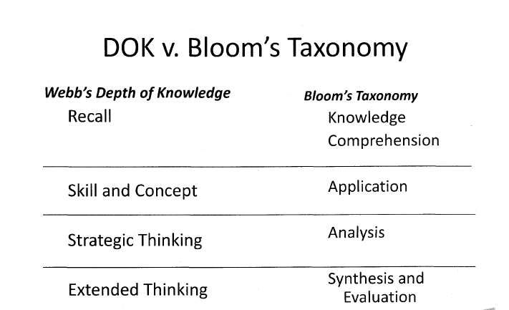

Slide 23
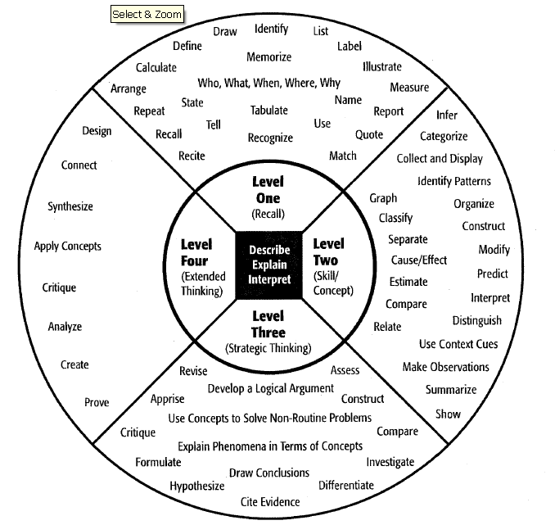

Slide 24
Anatomy of a Multiple-Choice Item
What is chiefly responsible for the increase in the average length of life in the USA during the last fifty years?
a. Compulsory health and physical education courses in public schools.
b. The reduced death rate among infants and young children.
c. The safety movement, which greatly reduced the number of deaths from accidents.
d. The substitution of machines for human labor.
stem
distractor
answer
alternatives
distractor
distractor

Slide 25
Item Selection
Select items that give you information about students’ progress toward mastery of the standard.
Do not select an item that needs major edits.
2. If an item aligns to the standard and is at the appropriate difficulty for the grade level, do not reject it because you think it is too hard for your students.
3. If an item aligns to the standard, do not reject it because it is not consistent with your current instructional materials.

Slide 26
Guidelines for Constructing Multiple Choice Items
1. Construct each item to assess a single content standard.
Base each item on a specific problem stated clearly in the stem.
  After reading the stem, the student should know exactly what the problem is and what he or she is expected to solve.
  If a student has to infer what the problem is, the item will likely measure the student’s ability to draw inferences from vague descriptions rather than their achievement level to a standard.

Slide 27
2. Base each item on a specific problem stated clearly in the stem.
Poor Example
California:
  Contains the tallest mountain in the United States.
  Has an eagle on the state flag.
  Is the second largest state in terms of area.
  Was the location of the Gold Rush of 1849.
Better Example
What is the main reason so many people moved to California in 1849?
  California land was fertile, plentiful, and inexpensive.
  Gold was discovered in central California.
  The east was preparing for a civil war.
  They wanted to establish religious settlements.

Slide 28
2. Stem may consist of either a direct question or an incomplete sentence, whichever presents the problem more clearly and concisely.
Direct Question Example
Which of the following was the principal keyboard instrument in 16th century Europe?
  Clavichord
  Harpsichord
  Organ
  Pianoforte
Incomplete Sentence Example
The principal keyboard instrument in 16th century Europe was the :
  Clavichord
  Harpsichord
  Organ
  Pianoforte

Slide 29
3. Include as much of the item as possible in the stem, but do not include irrelevant material.
Poor Example
If the pressure of a certain amount of gas is held constant, what will happen if its volume is increased?
  The temperature of the gas will decrease.
  The temperature of the gas will increase.
  The temperature of the gas will remain the same.
Better Example
If you increase the volume of a certain gas while holding the pressure constant, its temperature will:
  Decrease.
  Increase.
  Remain the same.

Slide 30
3. Include as much of the item as possible in the stem, but do not include irrelevant material.
Poor Example
Suppose you are a mathematics professor who wants to determine whether or not your teaching of the unit on probability has had a significant effect on your students. You decide to analyze their scores from a test they took before the instruction and their scores from another exam taken after the instruction. Which if the following t-tests is appropriate to use in this situation?
  Dependent samples
  Heterogeneous samples
  Homogeneous samples
  Independent samples

Slide 31
3. Include as much of the item as possible in the stem, but do not include irrelevant material.
Better Example
When analyzing your students’ pretest and posttest scores to determine if your teaching has had a significant effect, an appropriate statistic to use is the t-test for:
  Dependent samples
  Heterogeneous samples
  Homogeneous samples
  Independent samples
Several studies have indicated that including irrelevant material in the item stem decrease both the reliability and the validity of the resulting test scores (Haladyna & Downing, 1989).

Slide 32
4. State the stem in positive form (in general).
Just because the student knows an incorrect answer does not necessarily imply that he or she knows the correct answer.
The negative wording should be placed in the stem, not the alternatives, and should be emphasized by using underlining, italics, bold face, or CAPITALS.
When using a negative in the stem, each of the alternatives should be phrased positively to avoid forming confusing double negative with the stem.

Slide 33
Examples of Multiple Choice Items
Poor Example
All of the following are correct procedures for putting out a fire in a pan on the stove except:
Do not move the pan.
Pour water into the pan.
Slide a fitted lid onto the pan.
Turn off the burner controls
Better Example
All of the following are correct procedures for putting out a fire in a pan on the stove except:
Leave the pan where it is.
Pour water into the pan.
Slide a fitted lid onto the pan.
Turn off the burner controls.

Slide 34
5. Word the alternatives clearly and concisely.
Poor Example
The term hypothesis, as used in research, is defined as:
A conception or proposition formed by speculation or deduction or by abstraction and generalization from facts, explaining or relating an observed set of facts, given probability by experimental evidence or by factual or conceptual analysis but not conclusively established or accepted.
A statement of an order or relation of phenomena that so far as is known is invariable under the given conditions, formulated on the basis of conclusive evidence or tests and universally accepted, that has been tested and proven to conform to facts.
A proposition tentatively assumed in order to draw out its logical or empirical consequences and so test its accord with facts that are known or may be determined, of such a nature as to be either proved or disproved by comparison with observed facts.

Slide 35
5. Word the alternatives clearly and concisely.
Better Example
The term hypothesis, as used in research, is defined as:
An assertion explaining an observed set of facts that has not been conclusively established.
A universally accepted assertion explaining an observed set of facts.
A tentative assertion that is either proved or disproved by comparison with an observed set of facts.

Slide 36
6. Keep the alternatives mutually exclusive.
Poor Example
How long does an annual plant generally live?
Only one year.
Only two years.
Less than 5 years.
More than five years.
Better Example
How long does an annual plant generally live?
Only one year.
Only two years.
Between three and five years.
More than 5 years.

Slide 37
7. Keep the alternatives homogeneous in content.
Poor Example
Idaho is widely known as:
The largest producer of potatoes in the United States.
The location of the tallest mountain in the United States.
The state with a beaver on its flag.
The “Treasure State.”
Better Example
Idaho is widely known for its:
Apples
Corn
Potatoes
Wheat
The poor example contains alternatives testing knowledge of state agriculture, physical features, flags, and nicknames. When a student misses the item the teacher does not know which of the four areas the student is weak in.

Slide 38
8. Keep the alternatives free from clues as to which response is correct: a. Keep the grammar of each alternative consistent with the stem.
Poor Example
A word used to describe a noun is called an:
a. Adjective
b. Conjunction
c. Pronoun
d. Verb
Better Example
A word used to describe a noun is called:
a. An adjective
b. A conjunction
c. A pronoun
d. A verb

Slide 39
8. Keep the alternatives free from clues as to which response is correct: a. Keep the grammar of each alternative consistent with the stem.
Poor Example
Which of the following would do the most to promote the application of nuclear discoveries in medicine?
a. Trained radioactive therapy specialists.
b. Developing standardized techniques for treatment of patients.
c. Don’t place restrictions on the use of radioactive substances.
d. If the average doctor is trained to apply radioactive treatments.
Better Example
Which of the following would do the most to promote the application of nuclear discoveries in medicine?
a. Adding trained radioactive therapy specialists to hospital staffs.
b. Developing standardized techniques for treatment of patients.
c. Removing restrictions on the use of radioactive substances.
d. Training the average doctor to apply radioactive treatments.

Slide 40
8. Keep the alternatives free from clues as to which response is correct: b. Keep the alternatives parallel in form.
Poor Example
You have just spent 10 minutes trying to teach a new employee how to change a typewriter ribbon. The employee is still having a great deal of difficulty performing the task. At this point you should:
Tell the employee to ask an experienced employee working nearby to change the ribbon in the future.
Tell the employee that you never found this difficult, and ask what he/she finds difficult about it.
Have the new employee explain the process of changing the ribbon to you and determine where the misunderstanding is.
Tell the employee that you will continue teaching him/her later, because you are becoming irritable.

Slide 41
8. Keep the alternatives free from clues as to which response is correct: b. Keep the alternatives parallel in form.
Better Example
You have just spent 10 minutes trying to teach a new employee how to change a typewriter ribbon. The employee is still having a great deal of difficulty performing the task. At this point you should:
Ask an experienced employee working nearby to change the ribbon in the future.
Mention that you never found this difficult, and ask what he/she finds difficult about it.
Have the new employee explain the process of changing the ribbon to you and determine where the misunderstanding is.
Tell the employee that you will continue teaching him/her later, because you are becoming irritable.

Slide 42
Item Selection
Alicia can buy a single box of cereal that costs $2.89, or she can buy a multi-pack of 3 boxes that costs $8.43. How much will she save on each box if she buys the multi-pack?
$8.43 = $2.81, $2.89 – $2.81 = $0.08
3
A. $0.08
B. $0.24
Most students chose B.
C. $2.81
D. $5.54

Slide 43
Item Selection
What is the value of the expression 3x + 5 when x = 2?
What is the value of the expression 2y + 3 when y = 4?
3 x 2 = 6, 6 + 5 = 11
2 x 4 = 8, 8 + 3 = 11
A. 10 A. 9
Most students chose D.
B. 11 B. 11
C. 30 C. 24
D. 37 D. 27

Slide 44
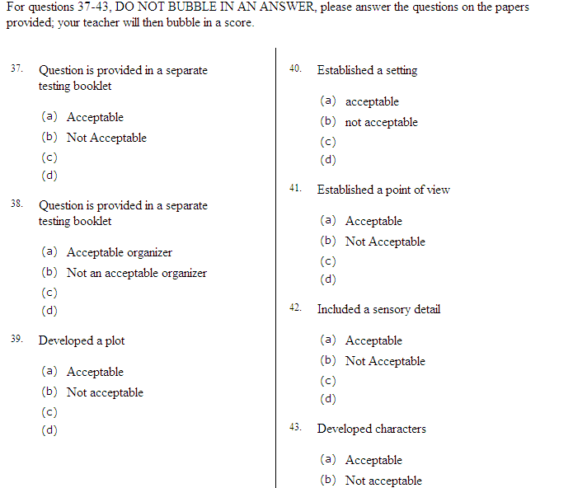

Slide 45
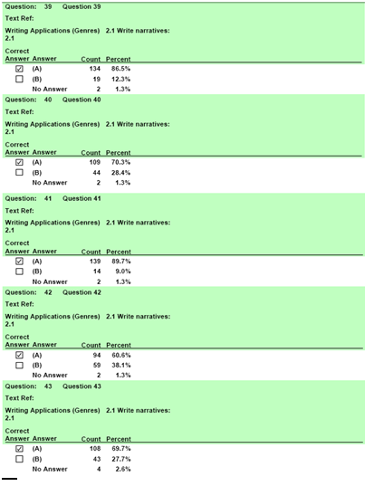
Developed a Plot
Established a Setting
Established a Point of View
Included Sensory Detail
Developed Characters

Slide 46
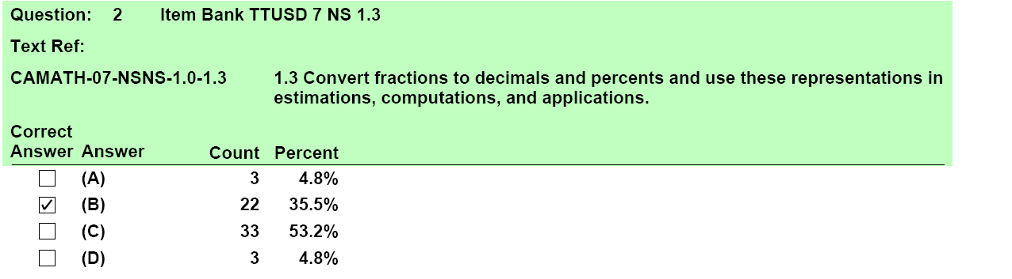
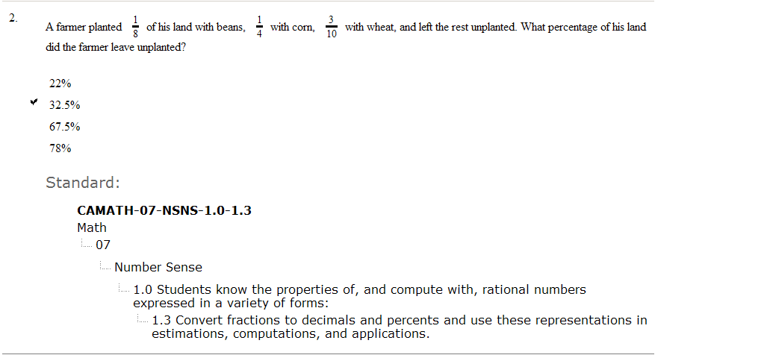
Correct Answer
33 Students selected 67.5%

Slide 47
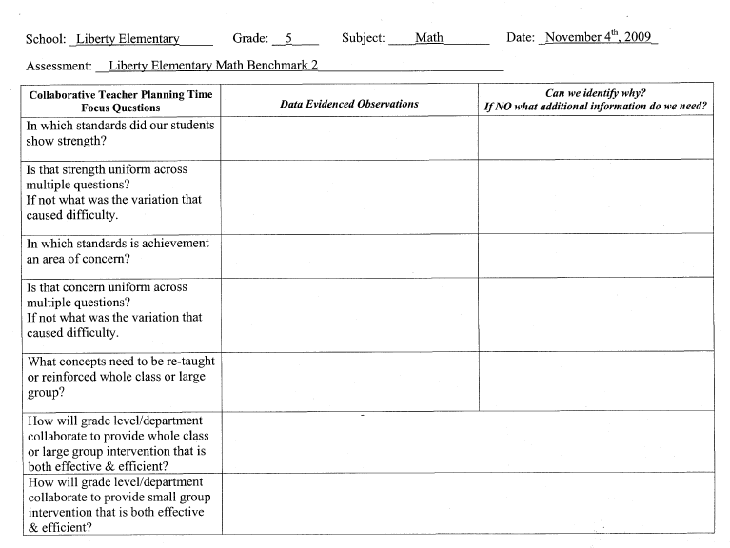
Data Driven Interventions

Slide 48
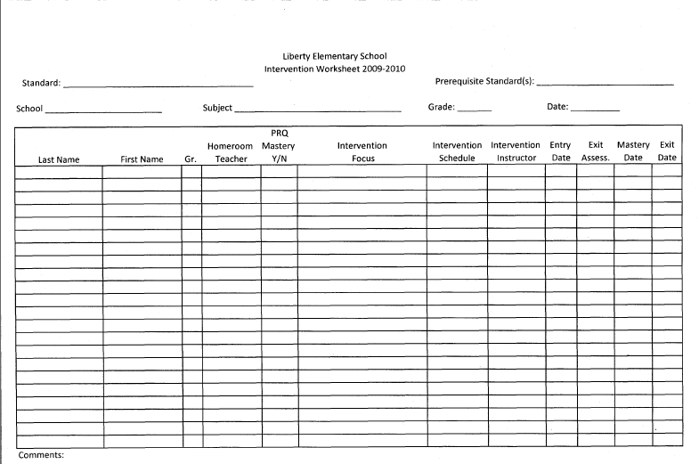
Data Driven Interventions

Slide 49
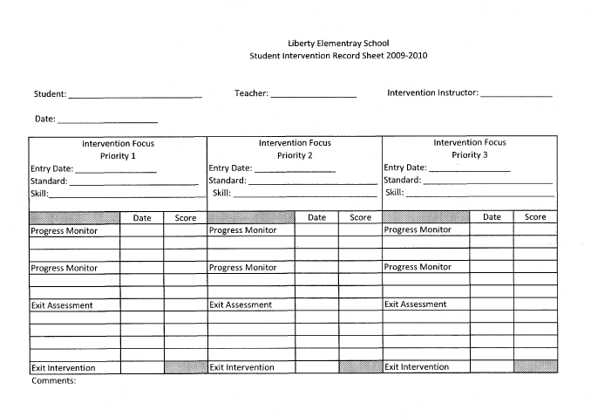
Data Driven Interventions

Slide 50
Item Selection
If an item aligns to the standard and is at the appropriate difficulty for the grade level, do not reject it because you think it is too hard for your students.
All these items were difficult for many students; however, the items were appropriate for the grade level, and they provided valuable information for PLC Team Collaborative Time.

Slide 51
Selecting High Quality Assessment Items
Answer the question:
  “What must my students be able to do or
  demonstrate for me to know they are proficient to
  this standard?”
What is (are) acceptable assessment formats to accurately assess this standard? MC, OR, Performance, Essay
If Selected Response find a stem that matches your answer to question one.

Slide 52
Selecting High Quality Assessment Items
4. Before examining the alternatives ask yourself: “What are the common mistakes my students make or misconceptions my students have regarding this standard?”
5. Look at the alternatives to ensure that the common mistakes and misconceptions you just identified are represented in the alternatives, if not change the alternatives.

Slide 53
Aligning curriculum and instruction to essential standards, pacing benchmarks, and interim assessment are the infrastructure for improvement.
Teachers working together to plan is highly correlated to increased student achievement.
The cycle of assessment, analysis, and action leads to long-term, lasting improvement.

Slide 54
PLC Collaborative Team Time
The interim assessments are for teachers and students. Unless teachers have timely access to the results, the tests are useless. In collaborative planning sessions, teachers review and analyze assessment data to:
Guide instruction.
Share effective teaching methods and materials.
Plan student interventions.
Identify professional development needs.

Slide 55
Deconstructing a Standard
What are the essential Vocabulary for this
standard?
Are there prerequisite skills that students must
have mastered before they can achieve mastery
to this standard/skills?
What must my students be able to demonstrate
for me to be confident that have exhibited
mastery to this standard?
What are the common mistakes or
misconceptions my students exhibit which
inhibits their learning of these concepts?

Slide 56
School Staff should spend time reviewing, discussing, unwrapping, and planning instruction around the Standards.
Number Sense and Operations 5.3
Use order of operations to solve problems
7 + (9 - 4) x 8 + 2

Slide 57
Addition
Subtraction
Multiplication

Slide 58
Addition
Subtraction
Multiplication
Parenthesis
Operations
Order

Slide 59
Addition
Subtraction
Multiplication
Parenthesis
Operations
Order
Apply standard to solve problems. Given a scenario, write an equation.

Slide 60
Addition
Subtraction
Multiplication
Parenthesis
Operations
Order
Apply standard to solve problems. Given a scenario, write an equation.
Textbook chapter 3 Pages 87-89
Supplemental daily “mini” lessons #s 10 – 20
Computer software volume 2

Slide 61
Addition
Subtraction
Multiplication
Parenthesis
Operations
Order
Apply standard to solve problems. Given a scenario, write an equation.
Textbook chapter 3 Pages 87-89
Supplemental daily “mini” lessons #s 10 – 20
Computer software volume 2
Documented observations
Weekly performance assessments
Interim assessments

Slide 62
Which students need support?
Action:
What support do they need?
How are we going to provide it?
____________
◻____________

Slide 63
Action:
A written plan that is standard specific and student specific, and:
1. Implemented based on student performance data;
2. Measured for effectiveness;
3. Revised as needed based on
outcomes.

Slide 64
Interventions
Focused on Content Standards
Targeted to Individual Students
Measured
Planned by Teachers
During the School Day (most effective)
Beyond the School Day (less effective)

Slide 65
Planning Interventions
Interventions must be planned collaboratively with all teachers (grade level or department) and administrators.
Must center on common, reliable achievement results
Must be aligned to standards
Must have an entrance criteria
Must be measured
Must have an established exit criteria

Slide 66
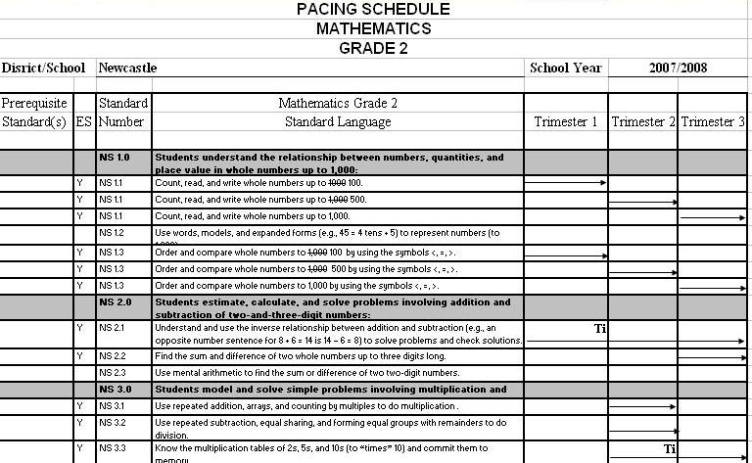

Slide 67
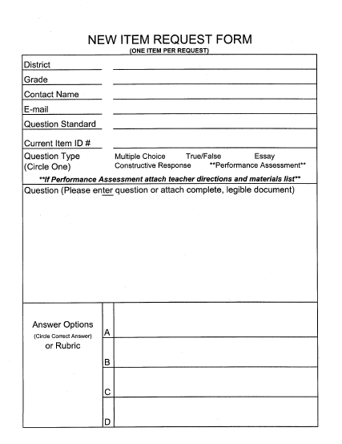

Slide 68
Answer the question:
  “What must my students be able to do or
  demonstrate for me to know they are
  proficient to this standard?”
2. Find a stem that matches your answer to question one.
Before examining the alternatives ask yourself:
“What are the common mistakes my students make or misconceptions my students have regarding this standard?”
Look at the alternatives to ensure that the
common mistakes and misconceptions you just
identified are represented in the alternatives,
if not change the alternatives.

Slide 69
Questions?
Contact Information:
Email: gwilliams@placercoe.k12.ca.us
Phone: (530) 745-1493
To download this PowerPoint go to:
http://www2.placercoe.k12.ca.us/departments/profdev/plc/Default.aspx
Click on Resources box and select:
“Building Assessments to Inform Instruction and Intervention”

